Slide 1


Slide 2

Pandas Introduction
Pandas is a powerful and open-source Python library. The Pandas library is used for data manipulation and analysis. Pandas consist of data structures and functions to perform efficient operations on data.
Pandas is well-suited for working with tabular data, such as spreadsheets or SQL tables

Slide 3
What is Python Pandas used for?
The Pandas library is generally used for data science, Pandas library is used in conjunction with other libraries that are used for data science. It is built on top of the NumPy library which means that a lot of the structures of NumPy are used or replicated in Pandas.
The data produced by Pandas is often used as input for plotting functions in Matplotlib, statistical analysis in SciPy, and machine learning algorithms in Scikit-learn.
Python’s Pandas library is the best tool to analyze, clean, and manipulate data.

Slide 4
Here is a list of things that we can do using Pandas.
Data set cleaning, merging, and joining.
Easy handling of missing data (represented as NaN) in floating point as well as non-floating point data.
Columns can be inserted and deleted from DataFrame and higher-dimensional objects.
Powerful group by functionality for performing split-apply-combine operations on data sets.
Data Visualization.

Slide 5
Installing Pandas
The first step in working with Pandas is to ensure whether it is installed in the system or not. If not, then we need to install it on our system using the pip command.
Follow these steps to install Pandas:
Step 1: Type ‘cmd’ in the search box and open it.
Step 2: Locate the folder using the cd command where the python-pip file has been installed.
Step 3: After locating it, type the command:
pip install pandas
Importing Pandas
After the Pandas have been installed in the system, you need to import the library. This module is generally imported as follows:
import pandas as pd

Slide 6
Data Structures in Pandas Library
Pandas generally provide two data structures for manipulating data. They are:
Series
DataFrame

Slide 7
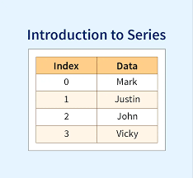
Pandas Series
A Pandas Series is a one-dimensional labeled array capable of holding data of any type (integer, string, float, Python objects, etc.). The axis labels are collectively called indexes.
The Pandas Series is nothing but a column in an Excel sheet. Labels need not be unique but must be of a hashable type.

Slide 8
Creating a Series
Pandas Series is created by loading the datasets from existing storage (which can be a SQL database, a CSV file, or an Excel file).
Pandas Series can be created from lists, dictionaries, scalar values, etc.
import pandas as pd a = [1, 7, 2] myvar = pd.Series(a, index = ["x", "y", "z"]) print(myvar)

Slide 9
Create a simple Pandas Series from a dictionary:
import pandas as pd calories = {"day1": 420, "day2": 380, "day3": 390} myvar = pd.Series(calories) print(myvar)
The keys of the dictionary become the labels.

Slide 10
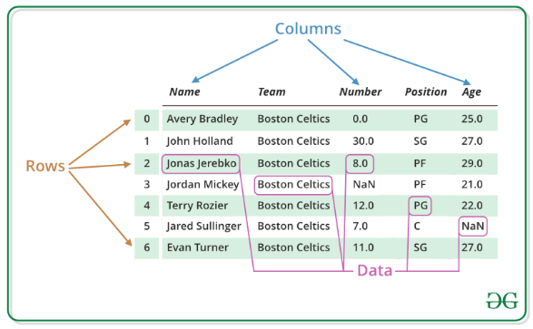
Pandas DataFrame
Pandas DataFrame is a two-dimensional data structure with labeled axes (rows and columns).

Slide 11
Creating DataFrame
Pandas DataFrame is created by loading the datasets from existing storage (which can be a SQL database, a CSV file, or an Excel file).
Pandas DataFrame can be created from lists, dictionaries, a list of dictionaries, etc.
Example: Creating a DataFrame Using the Pandas Library
import pandas as pd
# Calling DataFrame constructor
df = pd.DataFrame()
print(df)
# list of strings
lst = [‘rgukt', 'For', ‘students', 'portal', 'for', ‘CSE']
# Calling DataFrame constructor on list
df = pd.DataFrame(lst)
print(df)

Slide 12
Creating a DataFrame:
In the real world, a Pandas DataFrame will be created by loading the datasets from existing storage, storage can be SQL Database, CSV file, an Excel file. Pandas DataFrame can be created from the lists, dictionary, and from a list of dictionaries,
Syntax:
class pandas.DataFrame(data=None, index=None, columns=None, dtype=None, copy=None)
Parameters
Data ndarray (structured or homogeneous), Iterable, dict, or DataFrame
indexIndex or array-like
Columns Index:-Column labels to use for resulting frame when data does not have them, defaulting to Range Index(0, 1, 2, …, n). If data contains column labels, will perform column selection instead.
dtypedtype, default None:-Data type to force. Only a single dtype is allowed.
Copy bool or None, default None:-Copy data from inputs. For dict data, the default of None behaves like copy=True. For DataFrame or 2d ndarray input, the default of None behaves like copy=False.

Slide 13
Example
import pandas as pd
# Calling DataFrame constructor
df = pd.DataFrame()
print(df)
# list of strings
lst = [‘rgukt', ‘cse’, ‘students',
'pandas', ‘python‘, ’Data Frame’]
# Calling DataFrame constructor on list
df = pd.DataFrame(lst)
print(df)

Slide 14
Load Files Into a DataFrame
If your data sets are stored in a file, Pandas can load them into a DataFrame.
import pandas as pd df = pd.read_csv('data.csv')
print(df.to_string()) print(df)

Slide 15
Importing Excel files (single sheet)
Reading excel files (both XLS and XLSX) is as easy as the read_excel() function, using the file path as an input.
df = pd.read_excel('diabetes.xlsx')

Slide 16
Pandas - Analyzing DataFrames
One of the most used method for getting a quick overview of the DataFrame, is the head() method.
The head() method returns the headers and a specified number of rows, starting from the top.
There is also a tail() method for viewing the last rows of the DataFrame.
The tail() method returns the headers and a specified number of rows, starting from the bottom.
printingThe DataFrames object has a method called info(), that gives you more information about the data set. the first 10 rows of the DataFrame:
Info() will also give about Null Values in data

Slide 17
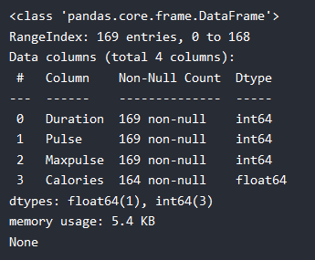
import pandas as pd df = pd.read_csv('data.csv') print(df.head(10))
print(df.tail()) #last 5 rows of the DataFrame:
print(df.info()) #more information about the data set.
The info() method also tells us how many Non-Null values there are present in each column, and in our data set it seems like there are 164 of 169 Non-Null values in the "Calories" column.
Which means that there are 5 rows with no value at all, in the "Calories" column, for whatever reason.
Empty values, or Null values, can be bad when analyzing data, and you should consider removing rows with empty values. This is a step towards what is called cleaning data, and you will learn more about that in the next chapters.

Slide 18
How to view data using .head() and .tail()
You can view the first few or last few rows of a DataFrame using the .head() or .tail() methods, respectively. You can specify the number of rows through the n argument (the default value is 5).
df.head()
df.tail(n = 10)

Slide 19
Outputting a DataFrame into a CSV file
A pandas DataFrame (here we are using df) is saved as a CSV file using the .to_csv() method. The arguments include the filename with path and index – where index = True implies writing the DataFrame’s index.
df.to_excel("diabetes_out.xlsx", index=False)
df.to_csv("diabetes_out.csv", index=False)
df.to_json("diabetes_out.json")
df.to_csv('diabetes_out.txt', header=df.columns, index=None, sep=' ')
As with writing DataFrames to CSV files, you can call .to_csv(). The only differences are that the output file format is in .txt, and you need to specify a separator using the sep argument.

Slide 20
Understanding data using .describe()
The .describe() method prints the summary statistics of all numeric columns, such as count, mean, standard deviation, range, and quartiles of numeric columns.
df.describe()
It gives a quick look at the scale, skew, and range of numeric data.
You can also modify the quartiles using the percentiles argument. Here, for example, we’re looking at the 30%, 50%, and 70% percentiles of the numeric columns in DataFrame df. df.describe(percentiles=[0.3, 0.5, 0.7])
You can also isolate specific data types in your summary output by using the include argument. Here, for example, we’re only summarizing the columns with the integer data type. df.describe(include=[int])
Similarly, you might want to exclude certain data types using exclude argument.
df.describe(exclude=[int])
Often, practitioners find it easy to view such statistics by transposing them with the .T attribute.
df.describe().T

Slide 21
Understanding your data using .shape
df.shape # Get the number of rows and columns
df.shape[0] # Get the number of rows only
df.shape[1] # Get the number of columns only
Get all columns and column names
df.columns
It can be converted to a list using a list() function.
list(df.columns)

Slide 22
Functions
DataFrame.groupby() | DataFrame.merge() | DataFrame.query()
DataFrame.sort() DataFrame.sum() | DataFrame.melt() DataFrame.merge() | DataFrame.iterrows() DataFrame.join()
DataFrame.to_excel() | DataFrame.pivot_table() | DataFrame.rename()
DataFrame.transpose() | DataFrame.query() | DataFrame.sample()
DataFrame.where() | DataFrame.shift() | DataFrame.shift()
DataFrame.transform() | DataFrame.mean() DataFrame.melt() | DataFrame.drop_duplicates()
DataFrame.iterrows() DataFrame.join() | DataFrame.head() DataFrame.hist() | DataFrame.apply() DataFrame.aggregate()
DataFrame.append() | DataFrame.count() DataFrame.cut() DataFrame.describe() | DataFrame.head() DataFrame.hist() DataFrame.mean()

